Slide 1

Environmental / Sustainability Initiatives
Bill Freeman
RFCI Meeting
October 16, 2013

Slide 2
FloorScore
NSF/ANSI 332 Sustainability Assessment for Resilient Floor Coverings
Environmental Product Declarations
Product Transparency Declaration

Slide 3
Floorscore
2005 – 5 Participating Companies
2013 – 108 Participating Companies
200 Manufacturing Sites
1580 Certified Product Lines
31 Hard Surface Categories

Slide 4
Floorscore
MJ International
Kraus Flooring
Shaw Industries
Franklin Industries
Hangzhou Zhengtian Industrial
Vertisol
W.F. Taylor Adhesives

Slide 5
Floorscore
NSF/ULE 440 Standard for Indoor Air Emissions from Building and Furnishings Products
Task Groups
  Toxicology
  Products & Environments

Slide 6
NSF/ANSI 332
Sustainability Assessment for
Resilient Floor Coverings
LCA Based
  Product Design
  Product Manufacturing
  Long Term Value
  End of Life Management
  Corporate Governance
  Innovation

Slide 7
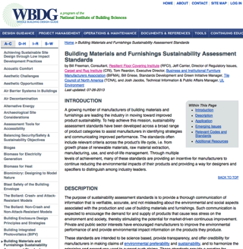
NSF/ANSI 332
Sustainability Assessment for
Resilient Floor Coverings
Whole Building Design

Slide 8
Environmental Product Declarations
A single, comprehensive disclosure of a product’s life cycle based environmental impact that has been validated by an independent third party.
An EPD reports the results of a product’s life cycle assessment (LCA) as well as other information relevant to a product’s environmental profile.

Slide 9
Environmental Product Declarations
Development Process
  Product Category Rules
  Collect LCA Data
  Verify LCA Data
  Create EPD
  Verify EPD
  Register EPD-Program Operator

Slide 10
Environmental Product Declarations
5 Industry Average EPDS
  Vinyl Composition Tile
  Luxury Vinyl Tile
  Homogeneous Vinyl
  Heterogeneous Vinyl
  Rubber Flooring

Slide 11
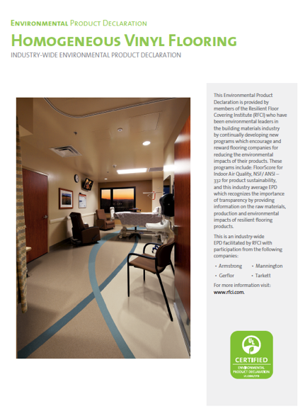

Slide 12
Environmental Product Declarations
Credits Available:
  Green Globes New Construction Standard
  USGBC LEED V4

Slide 13
Health Product declaration (HPD)
Health Product Declarations
HPD Introduced at Greenbuild – November 2012
HPD Standard describes a declaration of product content and direct health hazards associated with exposure to its individual contents.

Slide 14
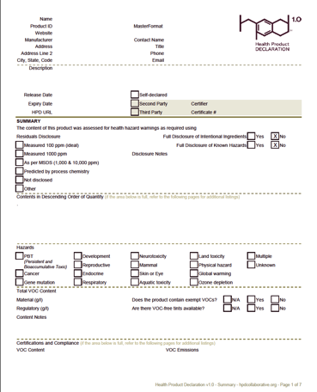
Health Product declaration (HPD)

Slide 15
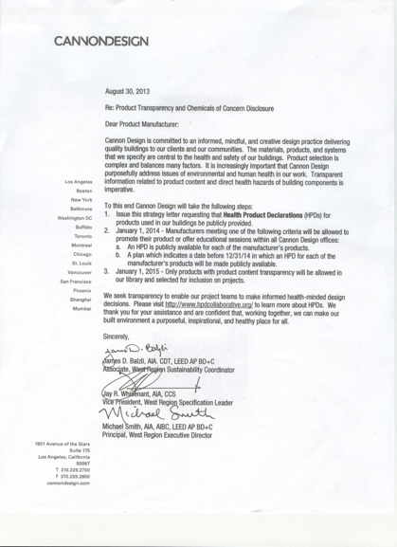

Slide 16
Product Transparency Declaration (PTD)
Provides product transparency
Based on exposure/risk versus hazard
Provides labeling/warning requirements

Slide 17
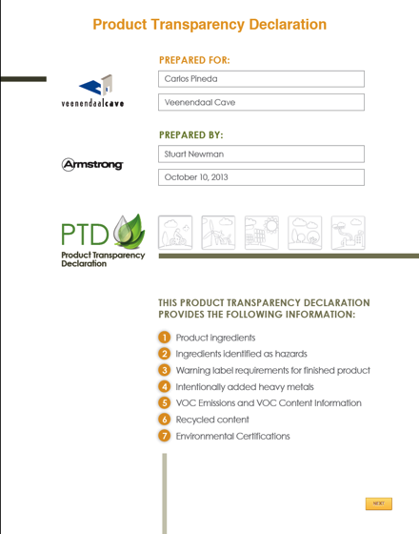

Slide 18
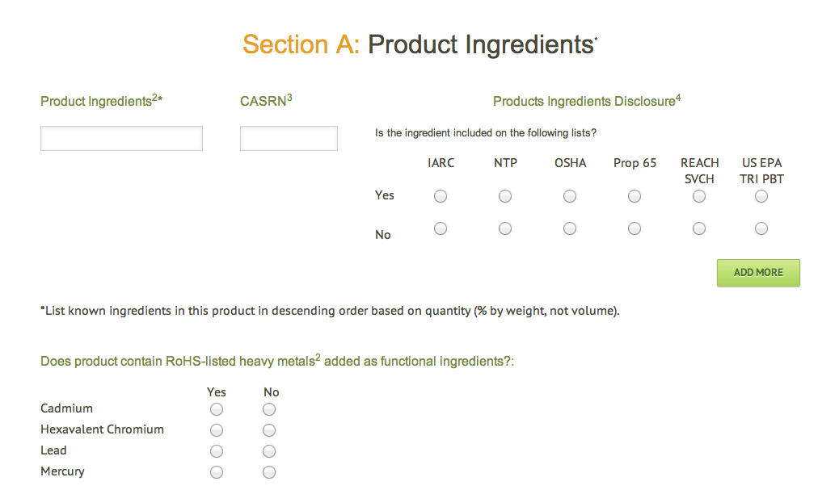

Slide 19
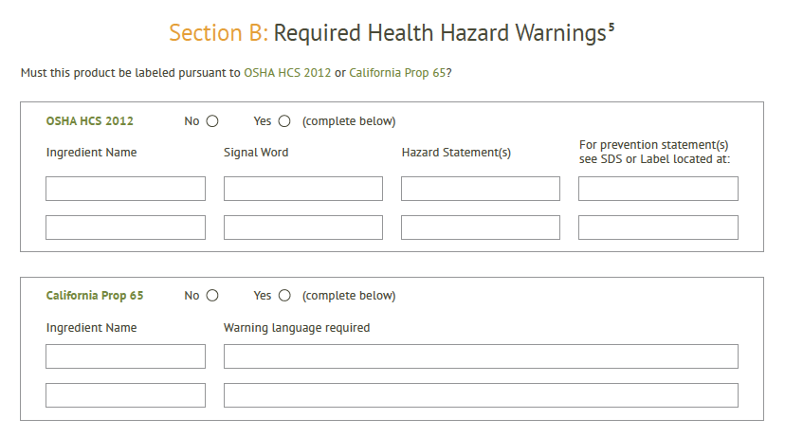

Slide 20
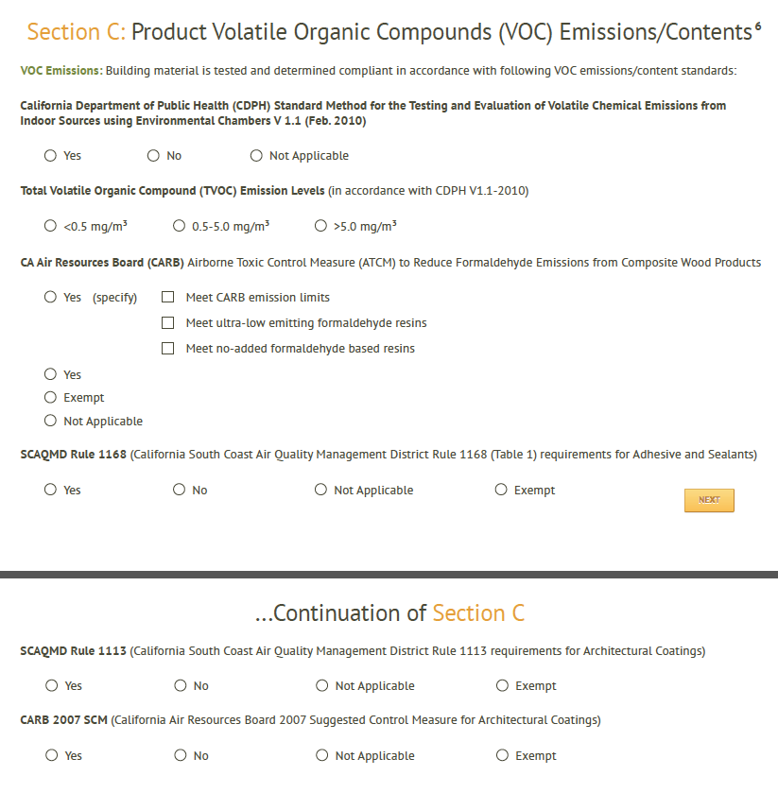

Slide 21
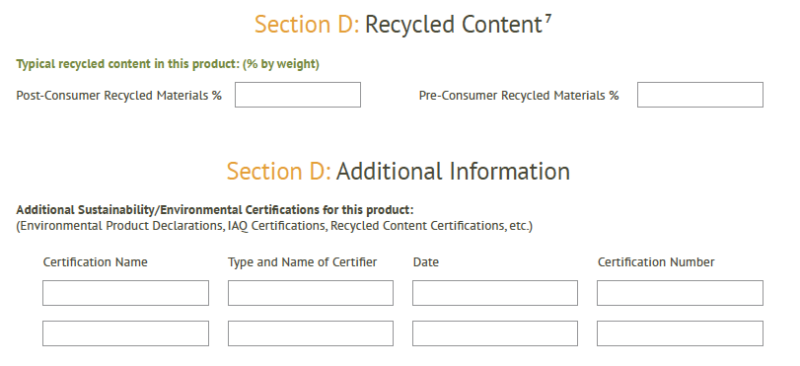

Slide 22
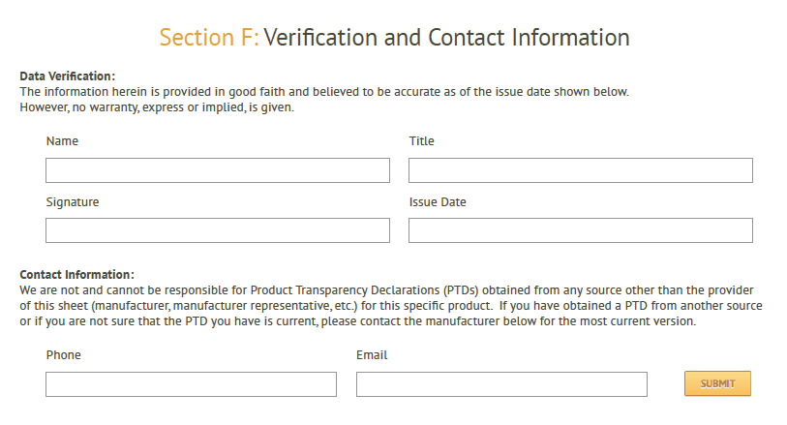

Slide 23
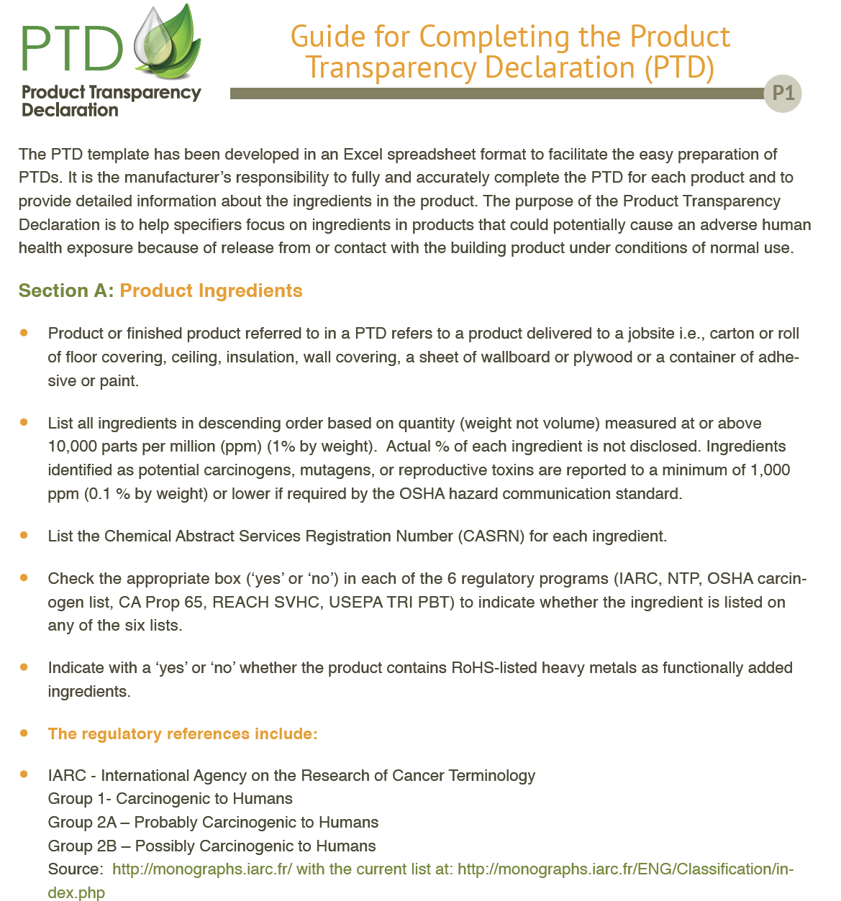

Slide 24
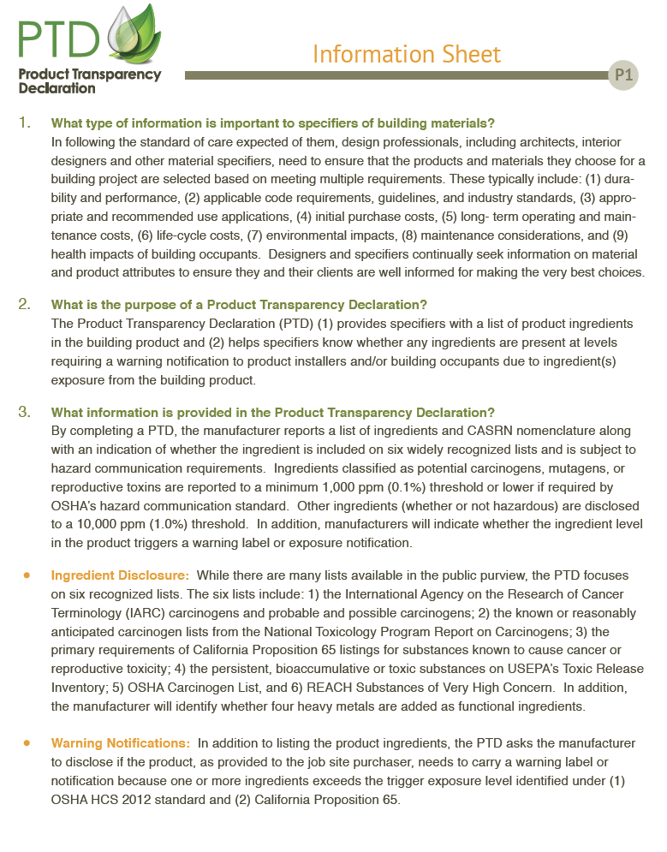

Slide 25
DIFFERENCES
Product Transparency Declaration (PTD)
VS
Health Product Declaration
(HPD)

Slide 26
PTD focuses on a finished product
delivered to a job site
VS
HPD focuses on pure raw materials
in a building product

Slide 27
PTD focuses on
ingredients, hazard lists and exposure/risk
for a finished building material
VS
HPD focuses on
ingredients and hazard lists.

Slide 28
PTDs use much less complicated
reporting method
VS
HPDs are so complex that
manufacturers are
hiring third party firms to complete HPD document

Slide 29
PTDs do not require disclosure of product formulas by reporting % of each product ingredient
VS
HPDs require the % of each ingredient to be disclosed including indication of whether % varies over time

Slide 30
PTDs require responsible company official to verify information
VS
HPDs encourage third party certification by listing options of self-certification, second and third party certification

Slide 31
PTD uses 6 authoritative hazard lists
VS
HPD uses 30+ hazard lists

Slide 32
PTD Authoritative lists
IARC – International Agency on the Research of Cancer Terminology
National Toxicology Program – Known Carcinogen and Reasonably Anticipated Carcinogen
OSHA – Occupational Safety and Health Administration Carcinogen List
Prop 65 – California Proposition 65, Known to Cause Cancer or Reproductive Toxicity
REACH – Substances of Very High Concern – Candidate List of Substances of Very High Concern

Slide 33
PTD Authoritative lists
Cancer
Reproductive Toxicity
Persistent, Biocumulative and Toxic Chemicals (PBTs)
Developmental Toxicity

Slide 34
HPD 30+ Hazard issuing agencies
Association of Occupational and Environmental Clinics (AOEC)
In 1991 developed a national surveillance database to capture newly diagnosed cases of occupational and environmental illnesses chronic injuries seen at AOEC Clinics
AOEC Database contains over 1,000 materials/ingredients in database
Group of physicians decide, based on case reports, which materials are classified as hazardous
Building product ingredients listed by AOEC as hazardous are required to be listed as hazards on HPD

Slide 35
Sample of materials on AOEC hazard List
Cement Dust
Carbon Black
Clay
Fiberglass
Plaster
Polyvinyl Chloride
Rubber Dust
Tooth Enamel Dust
Chlorine
Vinegar
Linseed Oil Cake
Camphor Oil
Thyme
Grain Dust
Coffee Bean
Sunflower
Corn Starch
Western Red Cedar
Frog
Cricket
Honey Bee
Fruit Fly

Slide 36
PTD does not require the use of GreenScreen, a program which is incomplete (still using draft assessments) and a non-consensus program that lacks a track record
HPD uses GreenScreen extensively to identify Benchmark 1 chemicals which have been so designated as “potentially” hazardous

Slide 37
PTD will be going through the ANSI Consensus Process to insure all stakeholders have an opportunity to participate in development of PTD
It is unclear about the process used to decide what is included in current and future HPDs.

Slide 38
Environmental Building News Webcast
Increased Transparency, Increased Liability for Designers
Moderators :
Russell Perry, VP SmithGroupJJR
Tristan Roberts, Editor LEED User
Bart Stasa, Chief Legal Officer - SmithGroupJJR
R. Craig Williams, Chief Legal Officer – HKS, Inc.
Richard Viktora, Chief Legal Officer – Skidmore, Owings & Merrill

Slide 39
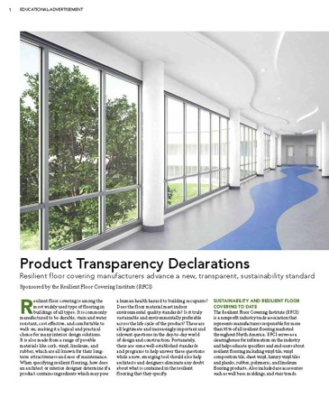

PTD/CEU

Slide 40
Product Transparency Declaration
Next Steps
ECO Commercial Building Annual Workshop - Pittsburgh
ASTM Committee E60 Sustainability
LEED V4 – M&R Credit 4
Greenbuild

Slide 41
THANK YOU!

